Slide 1
Server-side
Web Programming
Lecture 12:
Server-side Databases
and Drivers

Slide 2
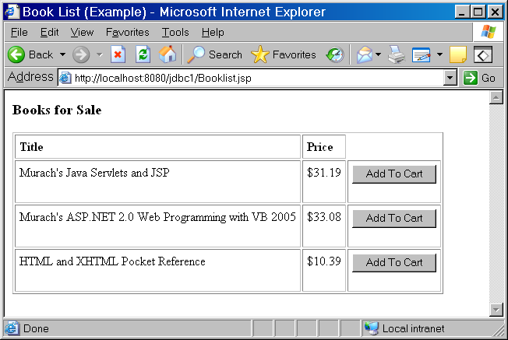
Databases and E-Commerce
Long term information stored in databases
  Queries used to produce lists of products
    Never hardwired in!
  Updates used to store orders
    New record created for order in Order table
    Customer information added to other tables
    Quantities updated in inventory tables
Generated by querying for all items in Books table

Slide 3
Databases and Web Programming
Updates to databases when orders placed
Queries to database to validate order
-- Does item exist?
-- Is it still in stock?
web container
control
servlet
database
JSP
Queries to database to display information to user
-- Query for all items in stock
-- Query to get order status, etc.

Slide 4
Databases and the MVC Paradigm
Usually do not directly access database from JSPs/servlets
  Requires both web programming and SQL knowledge
Usually done in model classes
  Cart object stores its content to database when commanded to
  Cart object created from database query when need to retrieve the cart
web container
database server
control
servlet
Model classes
database driver
database
JDBC
DBMS
JSP

Slide 5
Database Servers
Access to database controlled by database server
  Constantly running (like web container)
  Programs communicate with it
  Server runs database queries and updates for databases it controls
  Server handles security of database
    Most are password-controlled
  Examples:
    MySQL (free)
    Oracle
    MS Server
    Not Access!
Database server
database
Web app

Slide 6
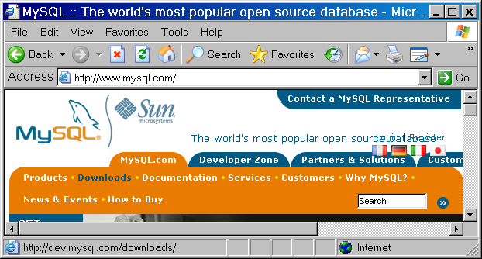
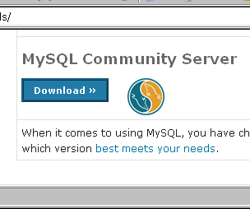
MySQL
Free database server
See page 348 for instructions
  Go to www.mysql.com
  Follow downloads tab
  Go to MySQL Community Server
  Get Windows version
  Pick a mirror
    You can skip registration
  Download and run

Slide 7
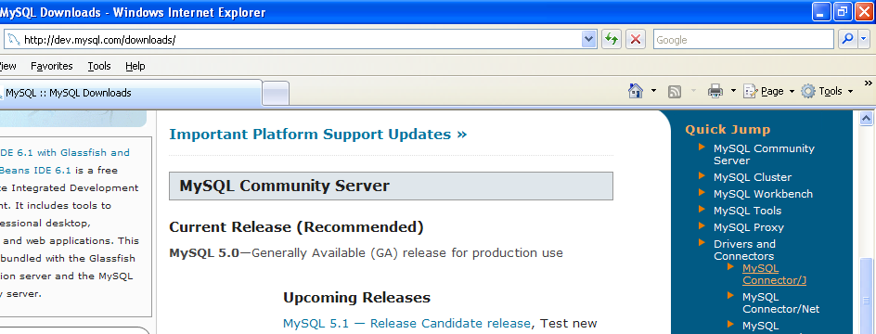
MySQL Database Driver
From downloads page at mysql.com
Go to MySQL Connector/J
Download and save

Slide 8
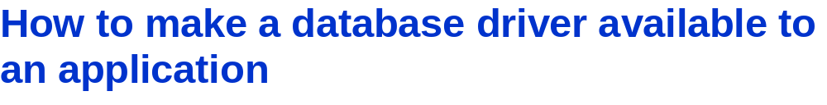
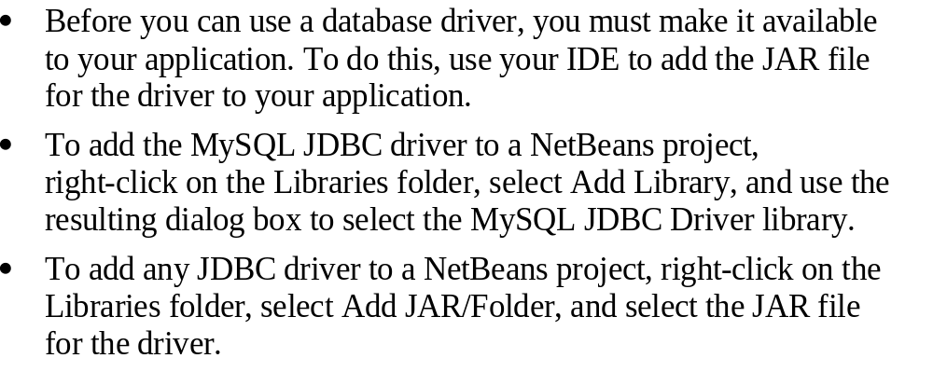

Slide 9
JDBC Definition
Java Database Connectivity (JDBC): set of classes that provide methods to
  Connect to a database through a database server (using a driver)
  Query database using SQL syntax, getting “list” of records that match query
  Manipulate database by executing SQL commands to modify, insert, and delete records
web container
database server
control
servlet
Model classes
database driver
database
JDBC
DBMS
JSP

Slide 10
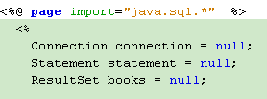
JDBC Components
Major objects involved:
  Connection: represents connection to a database through a server
  Statement: represents SQL statement executed on database via that connection
  ResultSet: represents “list” of records matching a query
Database server
Statement object
select * from books
database
ResultSet object
productCode title price
productCode title price
productCode title price

Slide 11
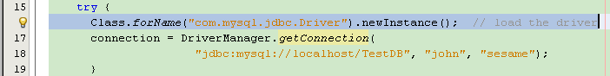
Connecting to the Database Server
Load the database driver
  Not necessary in most recent version, but safe thing to do
  Syntax:
  Class.forName("driver class").newInstance();
Name of driver class based on url of provider
Example: com.mysql.jdbc.Driver

Slide 12

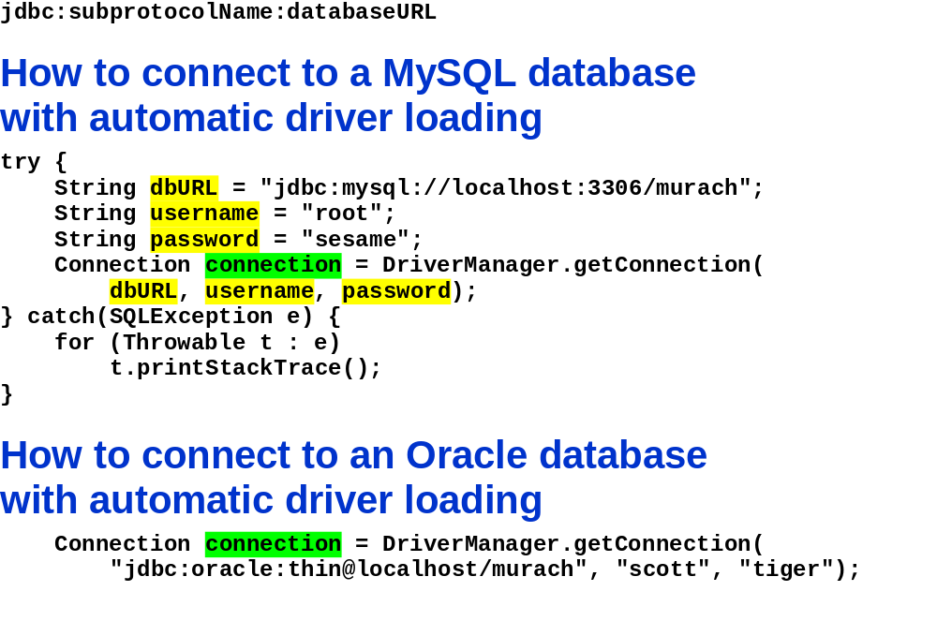

Slide 13
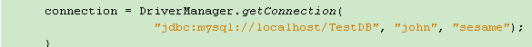
Connecting to the Database Server
Connect to the database
  Need to provide username and password
Need to provide url of database
Usual form: jdbc:server type:url of server/database name
Example: jdbc:mysql://localhost/TestDB
Syntax:
connectionobject =
DriverManager.getConnection("databaseURL",
"username", "password");

Slide 14

Exception Handling in JDBC
Any database-related statement may throw an SQLException
  Your code must put in try/catch block
  May also need to catch other exceptions
    ClassNotFoundException for missing database driver
Diagnostic message displayed
Better idea: Redirect to an error page

Slide 15
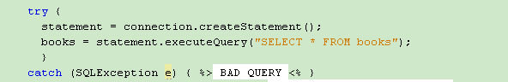
Executing Queries
Create new statement object using the connection
Execute an SQL query using that statement
Store results in a ResultSet object
Syntax:
statement = connection.createStatement();
statement.executeQuery(“SQL query”);

Slide 16
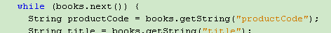
Reading ResultSets
Can only do simple access:
  Read in field values from current record
  Move to next record
Syntax to move to next record: ResultSetObject.next();
  Returns false if no next record, true otherwise
  Must execute once before reading first record
  Usually while loop to read until no more records
  while(ResultSetObject.next()) {
  code to read in current record
  }

Slide 17
Reading ResultSets
Syntax to read field from current record:
value = ResultSetObject.getType(fieldname);
Specify type data is to be read in as
varChar → getString
int → getInt
double → getDouble
Specify field name used in database

Slide 18
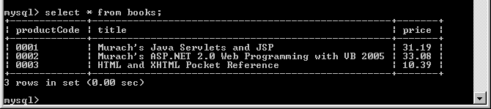
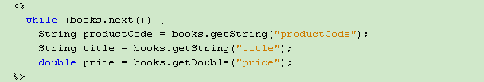
Reading ResultSets

Slide 19
Reading ResultSets
Once ResultSet read in, can use in own code
  Display in JSP
  Store in array for future use, etc.

Slide 20
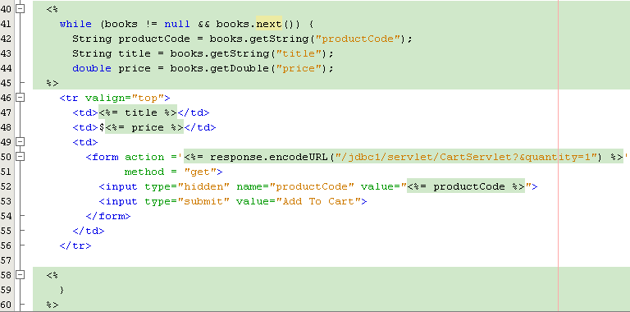
Reading ResultSets
Display title and price in next table row
Create form that passes productCode of selected book to servlet if button on this row is pressed

Slide 21
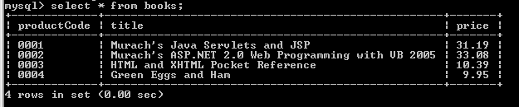
Executing Update Statements
Syntax:
Statement statement = connection.createStatement();
statement.executeUpdate(“SQL statement”);
Example:
statement.executeUpdate(“INSERT INTO books
(productCode, title, price)
VALUES (‘0004’, ‘Green Eggs and Ham’, 9.95)”);

Slide 22
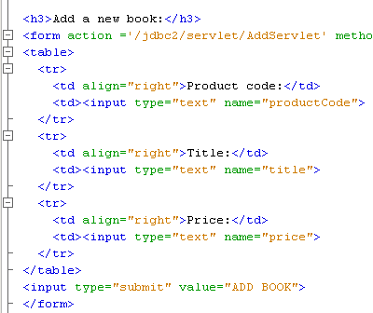
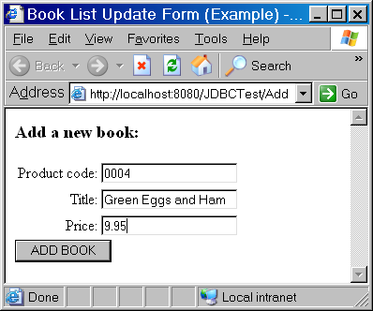
Inserting Parameter Values
User often decides how database is updated
  Enters parameter on form
  Parameters used for update

Slide 23
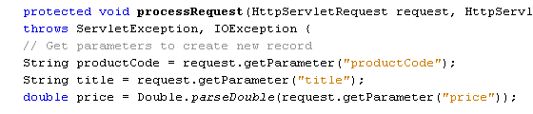
Inserting Parameter Values
Read in parameter values
  Validate if necessary

Slide 24
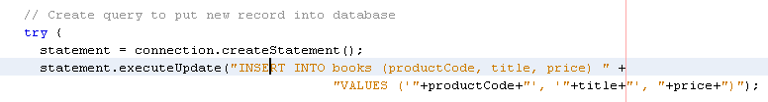
Inserting Parameter Values
Insert into SQL statement
  Will need to use + to append values into SQL statement string
  Note that string values must be inside ‘ ’ to avoid syntax errors
0004
9.95
Green Eggs and Ham
Creates string of form:
INSERT INTO books (productCode, title, price) VALUES (‘0004’, ‘Green Eggs and Ham’, 9.95)

Slide 25
Validation and Updates
Usually need to validate update with database to avoid problems
  Don’t add item if already in database
  Don’t update or remove if not in database
    Won’t cause database error, but probably want to inform user
Checking whether item in database involves query
  Create query from item in question
  If no results then not in database
  Key idea: use statement of form if(ResultSetObject.next())
    True if at least one result
    False if no matches

Slide 26
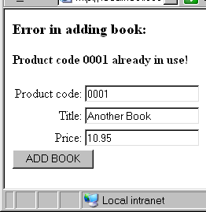
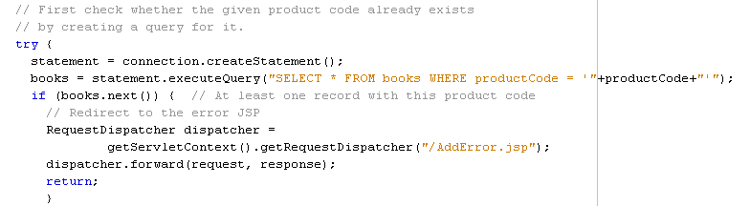
Validation and Updates
Example:
Validating that no book with given productCode exists in database before adding it
  Query for book with that productCode
  Redirect to error page if books.next() is true

Slide 27
Efficient and Safe Database Access on Web Servers

Slide 28
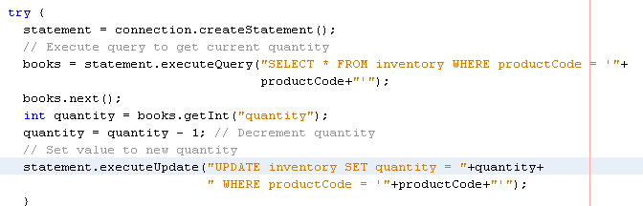
Synchronized Database Access
Many database updates can occur “simultaneously” on busy sites
Can interfere with one another
Example: Quantity update after purchase
  Query for previous quantity
  Subtract 1
  Update database with new quantity

Slide 29
Synchronized Database Access
Java runs separate clients as “parallel” threads which execute “simultaneously”
  Processor swaps back and forth between threads
Problem if following sequence occurs:
  Current quantity = 100
  Client 1 code to get current quantity executes (value = 100)
  Processor swaps to client 2 thread
  Client 2 code to get current quantity (value still = 100)
  Client 2 code sets new quantity to 99 and stores in database
  Processor swaps back to client 1 thread
  Client 1 code also sets new quantity to 99 and stores in database!

Slide 30
Synchronized Database Access
Problem: this code should not be interrupted!
Client 1 thread
Get quantity
Quantity = 100
Set quantity = 99
Store 99 in
database
Client 2 thread
Get quantity
Quantity = 100
Set quantity = 99
Store 99 in
database

Slide 31
Synchronized Database Access
Can declare sections of code to be synchronized
  Only one thread may execute it at a time
  Another thread cannot start the code until the first has finished it
Syntax: synchronized(object) { code }
Only one thread at a time should be able to execute this code on this object

Slide 32
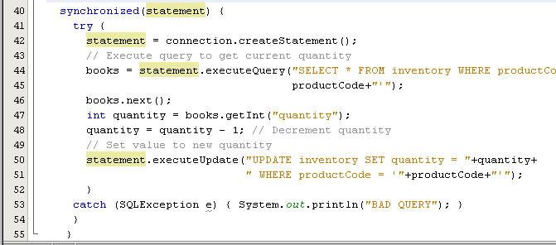
Synchronized Database Access

Slide 33
Efficiency in Database Access
Database access most time consuming part of most e-commerce transactions
Most costly parts:
  Creating new connections to database
  Creating new statements using those connections
Idea:
Do as much as possible in advance
  Prepared statements
  Connection pooling

Slide 34
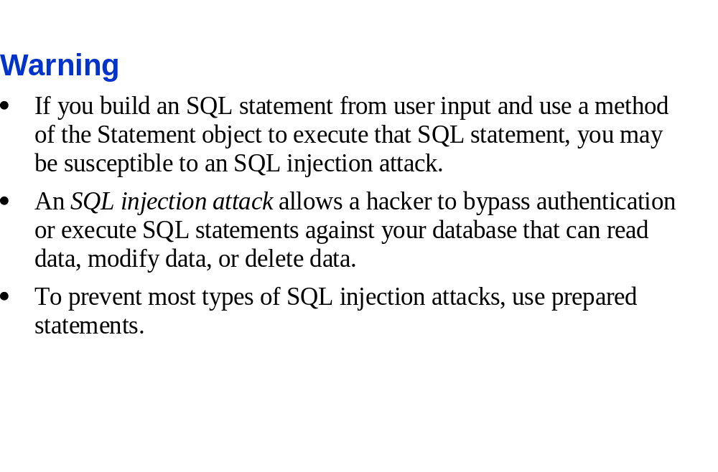

Slide 35
Prepared Statements
Executing a statement takes time for database server
  Parses SQL statement and looks for syntax errors
  Determines optimal way to execute statement
    Particularly for statements involving loading multiple tables
Most database statements are similar in form
Example: Adding books to database
  Thousands of statements executed
  All statements of form:
  "SELECT * FROM books WHERE productCode = ____“
  "INSERT INTO books (productCode, title, price)
  VALUES (_____, _____, ______)"

Slide 36
Prepared Statements
Tell database server about basic form of statements in advance
  Database server can do all work for that type of statement once
“Fill in blanks” for actual values when actually execute statement
  Hard work already done
Syntax:
  Define PreparedStatement object instead of Statement
  PreparedStatement check = null;
  PreparedStatement insert = null;

Slide 37
Prepared Statements
Define prepared statement using connection.prepareStatement
Place ‘?’ where actual values will be inserted
check = connection.prepareStatement("SELECT * FROM
books WHERE productCode = ?");
insert = connection.prepareStatement("INSERT INTO
books (productCode, title, price)
VALUES (?, ?, ?)");

Slide 38
Prepared Statements
Use setType (index, value) to insert values into the statement
productCode = request.getParameter("productCode");
title = request.getParameter("title");
price = Double.parseDouble(request.getParameter("price"));
check.setString(1, productCode);
insert.setString(1, productCode);
insert.setString(2, title);
insert.setDouble(3, price);
Type of field (like get method in ResultSet)
Which ‘?’ to insert the value into
Insert productCode into first (and only) ‘?’ in check
Insert productCode, title, and price into first, second, and third ‘?’s respectively in insert
Note that price is inserted as double

Slide 39
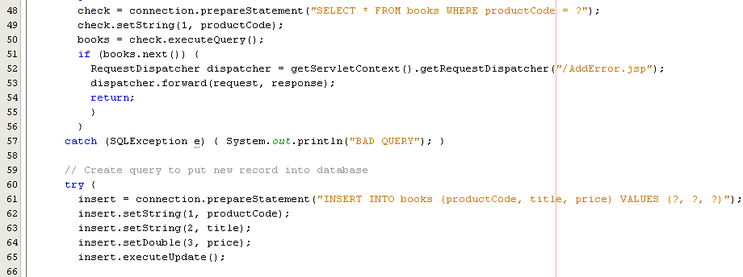
Prepared Statements
Execute statements as before
  No parameters for SQL, since form already set

Slide 40
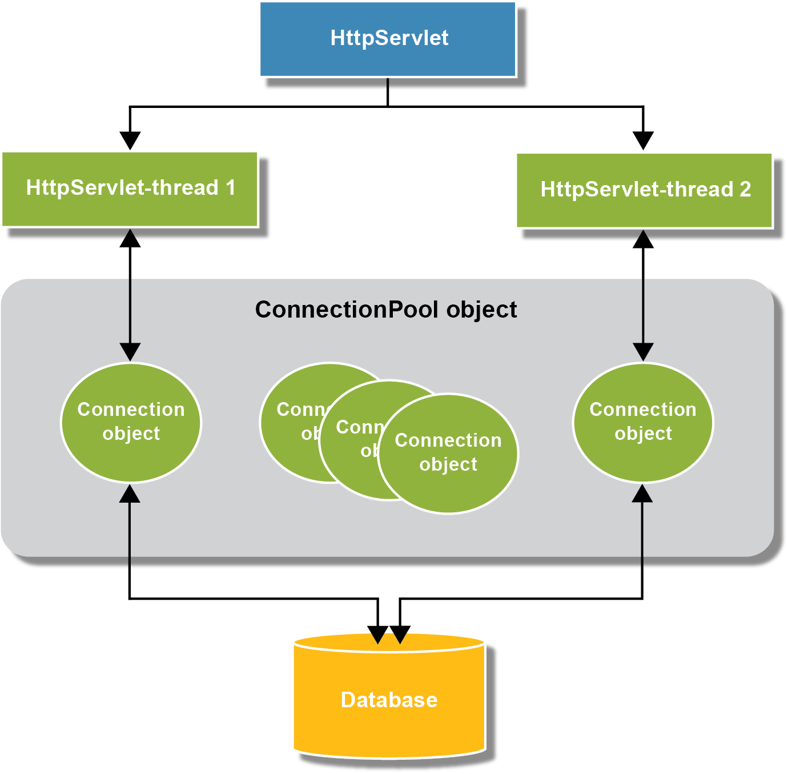

Slide 41
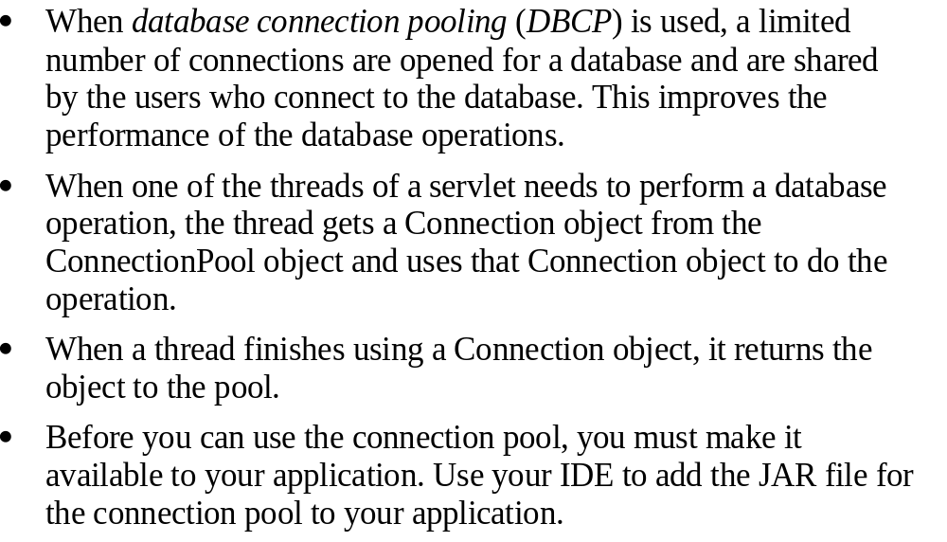

Slide 42
Connection Pooling
Every time client sends request, new connection to database created
  May be many current connections (one per thread)
  Most time consuming part of process
Solution:
Create pool of connections in advance
  No overhead when actual requests made later by clients
web container
Connection pool
database server
database

Slide 43
Connection Pooling
When connection requested:
  Get unused connection from pool
Connections currently in use
web container
JSP/servlet
Connection pool
database server
JSP/servlet
database
Request for new connection
New
JSP/servlet
Free unused connection

Slide 44
Connection Pooling
When connection requested:
  Connection used by servlet/JSP
Connections currently in use
web container
JSP/servlet
Connection pool
database server
JSP/servlet
database
New
JSP/servlet
Reference to unused connection returned
Free unused connection

Slide 45
Connection Pooling
When finished, JSP/servlet returns the connection back to the pool
  Now free for use by another
Connections currently in use
web container
JSP/servlet
Connection pool
database server
JSP/servlet
database
Return to pool
New
JSP/servlet
Free unused connection

Slide 46
Connection Pooling
Unlike prepared statement, no built in Java methods/classes
  Write your own
    http://java.sun.com/developer/onlineTraining/Programming/JDCBook/conpool.html
  Third party classes
    dbConnectionBroker, etc.
  Build components directly into web.xml/context.xml files
    Page 466 of text
    Not well supported by Tomcat

Slide 47
Connection Pooling
Usually static object
  Automatically constructs connections first time getConnection called
Usually provide following methods:
  ConnectionPool.getInstance()
  freeConnection()
Example:
Connection connection = ConnectionPool.getInstance();
// Code that creates statement, executes queries, etc.
connection.freeConnection();

Slide 48
Connection Pooling
Required parameters:
  Driver name
    "com.mysql.jdbc.Driver“
  Url, name, and password
    "jdbc:mysql://localhost/bookstore",
    “root", “sesame"
  Number of initial connections to create
    Usually a few hundred to a few thousand
  Timeout for idle connections
    Time after which idle connections are returned to pool automatically
    Important to prevent pool running out!
Necessary so connection pool can connect to database

Slide 49

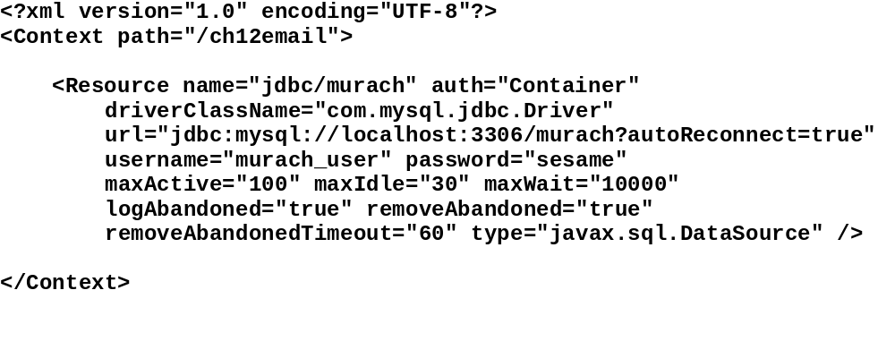

Slide 50
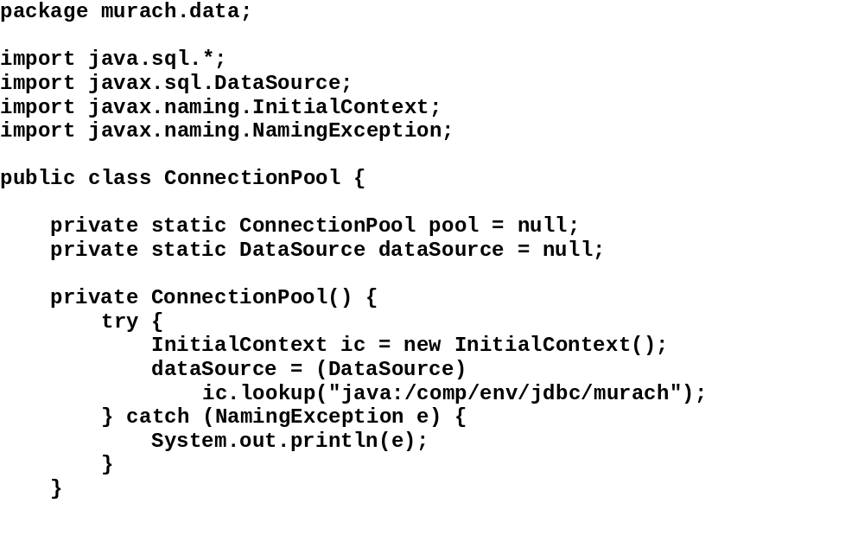

Slide 51
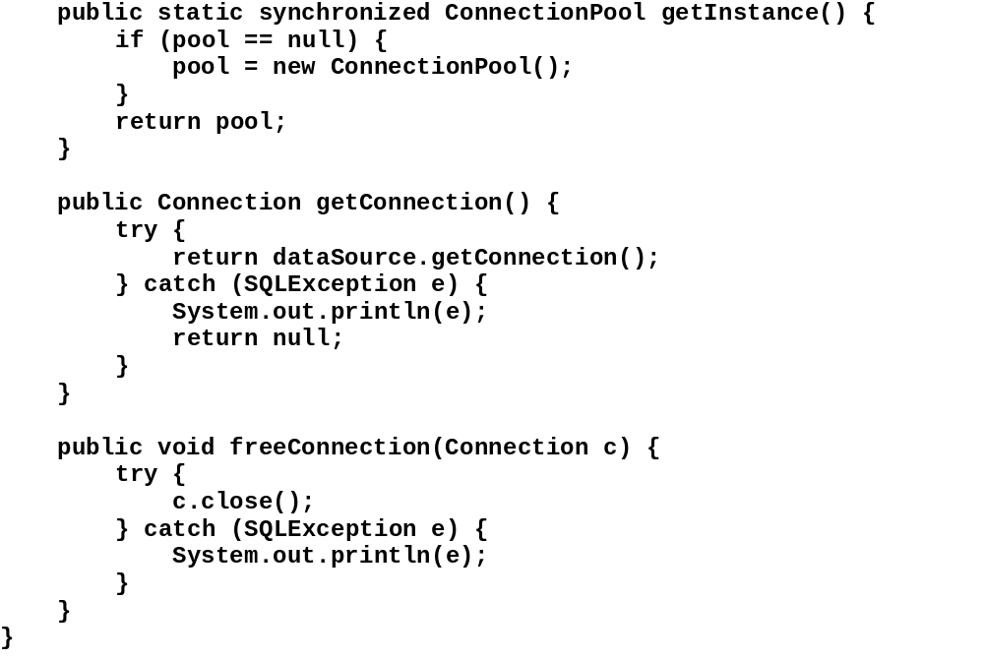

Slide 52
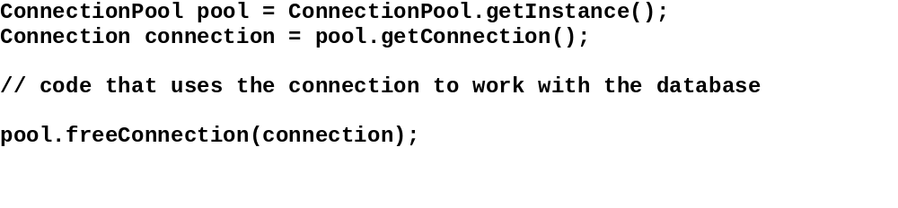

Slide 53
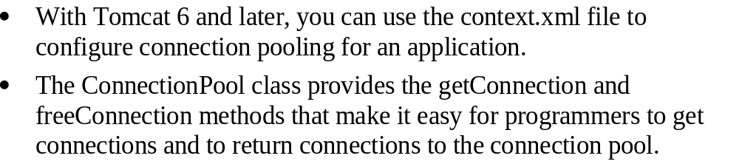

Slide 54

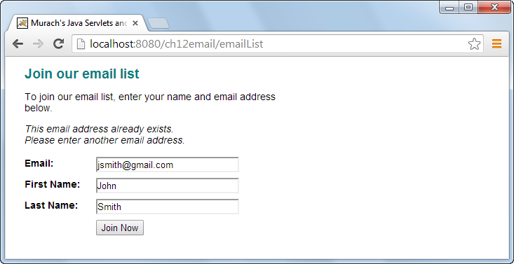

Slide 55

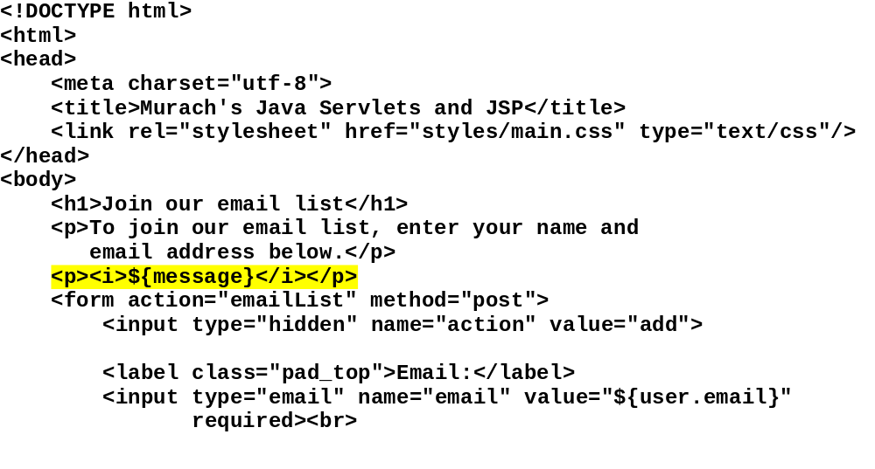

Slide 56
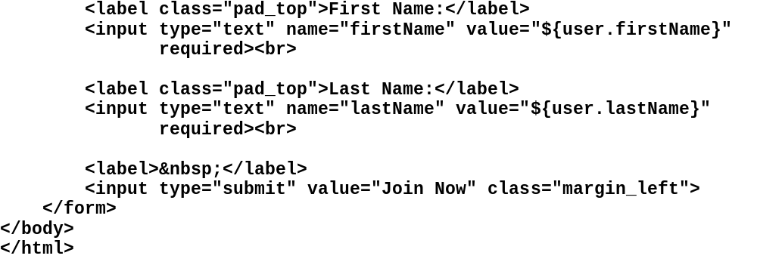

Slide 57
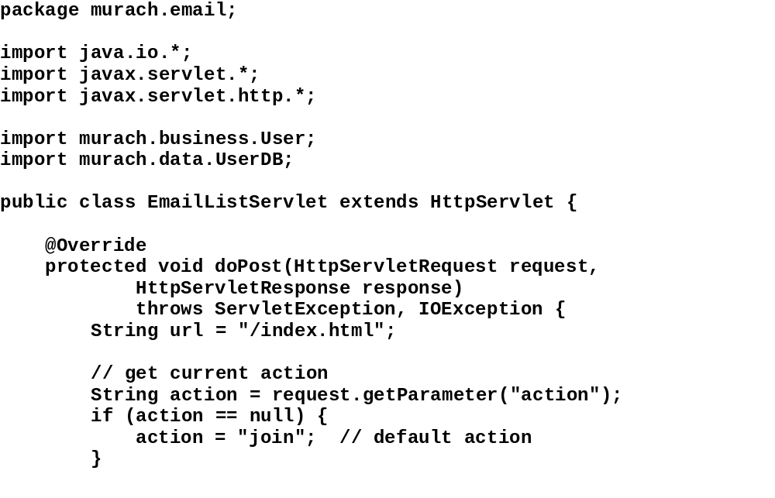

Slide 58
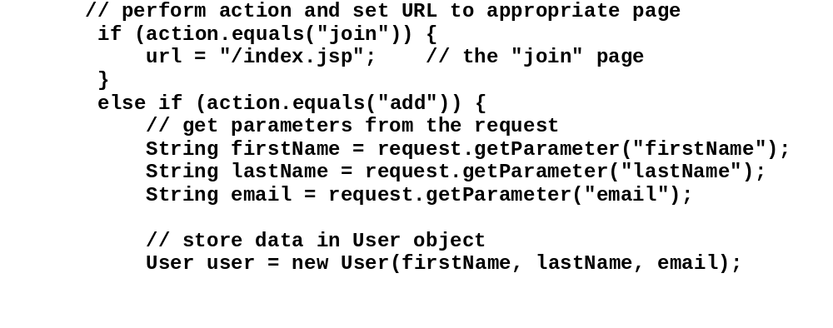

Slide 59
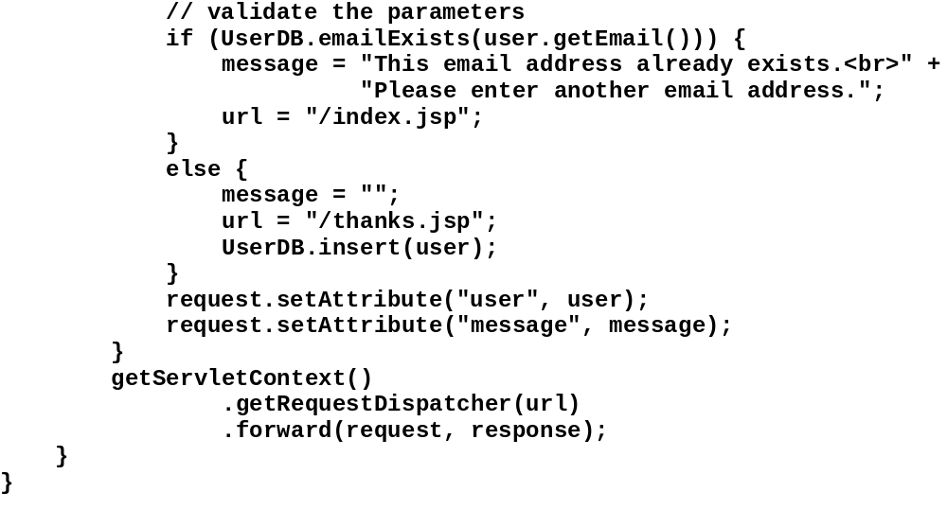

Slide 60
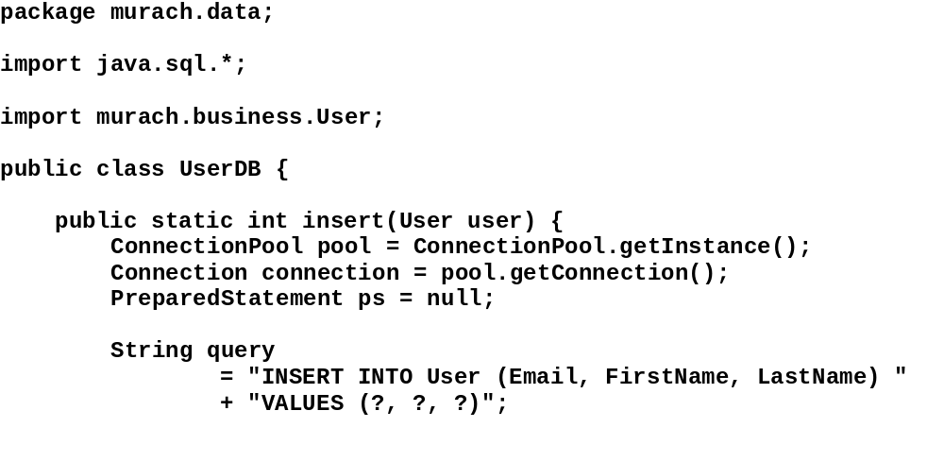

Slide 61
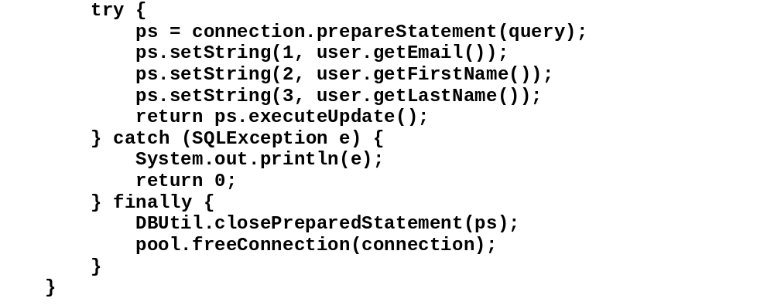

Slide 62
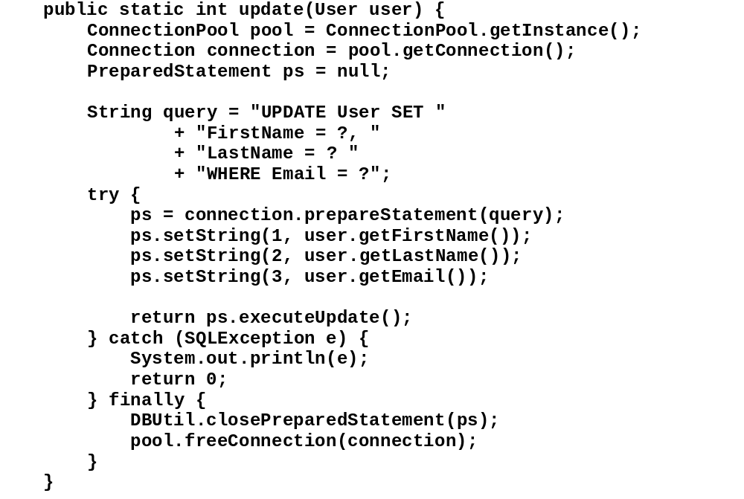

Slide 63
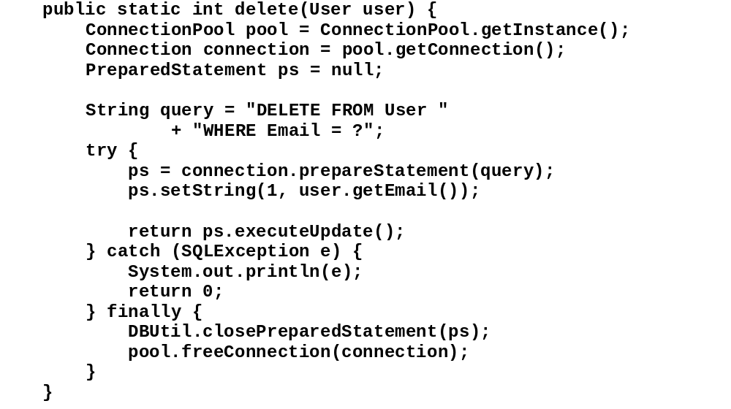

Slide 64
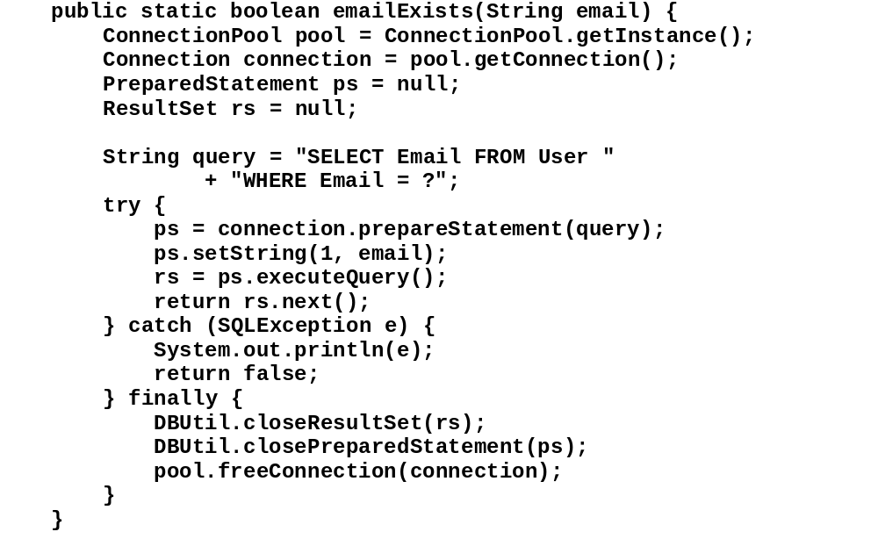

Slide 65
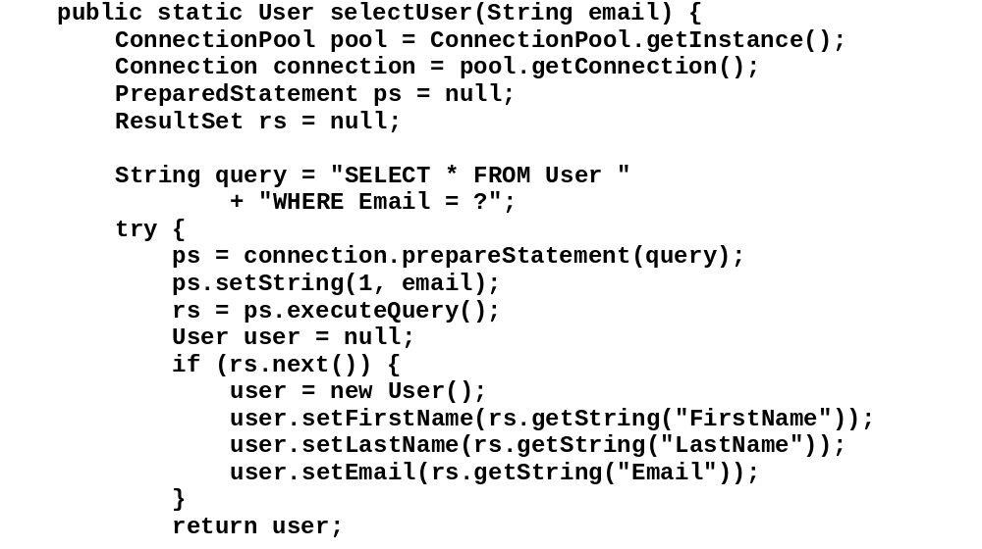

Slide 66
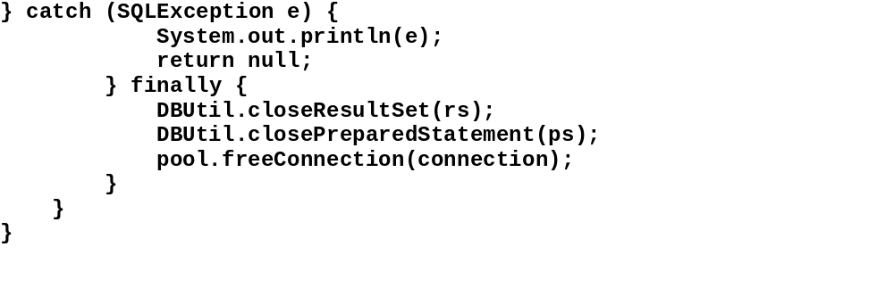

Slide 67
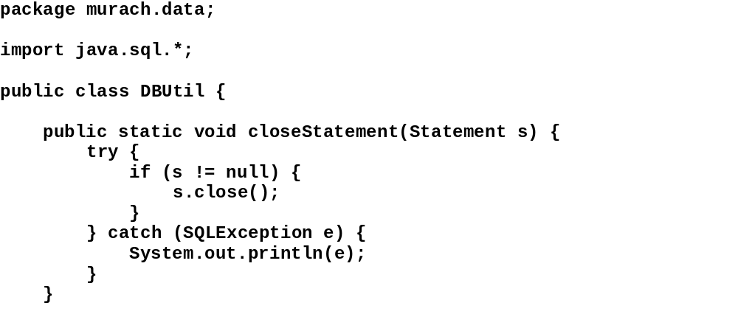

Slide 68
